Slide 1
UML Study Buddy App
Hussain Dar and Sridhar Rangan

Slide 2
Goal
UML Study Buddy App is designed to help students get to know other students in specific classes
This is so that these students can meet up to work together on homework, study for quizzes and exams, and do group projects together.
The app will be available for all students and will help introverted students and those who need help in their classes find additional help with peers.

Slide 3
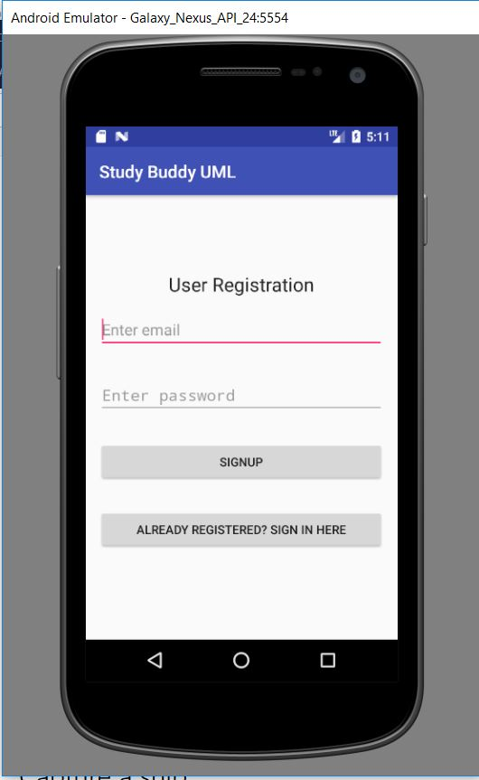
Login Page
This prompts the user to register an email for the Study Buddy Application.
If the User already has an account, they can click the button at the bottom which will bring them to a user sign on page.
Should the account exist the database, it will welcome the user

Slide 4
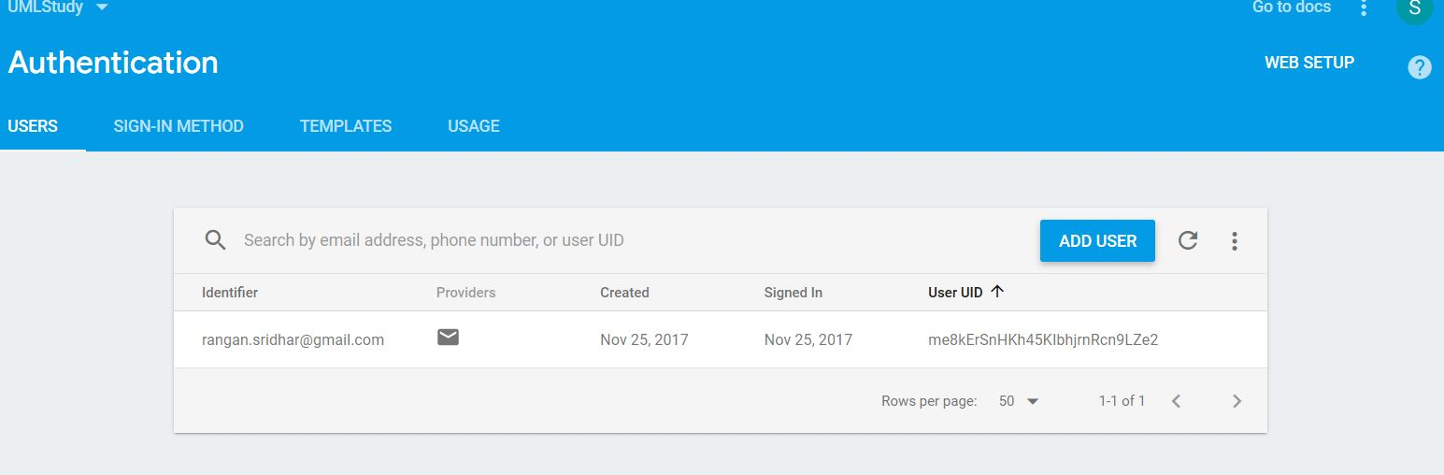
Added User into Database

Slide 5
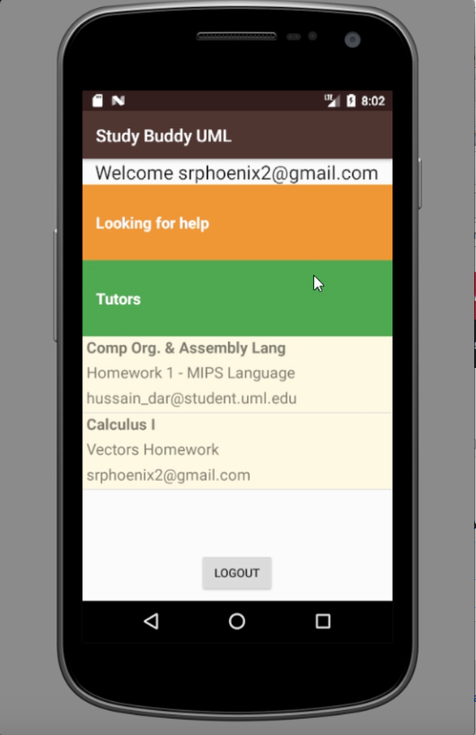
Main Page
Here we have the main page that allows the user to decide whether they want to search for a tutor or asking someone for help in a specific class
Clicking on the looking for help option shows you a list of class with their course number you can get help with. Your request will displayed on the main page along with your email
Notes:
Clicking on the

Slide 6
Future Implementations
Background music because everyone loves music
Make the app parse the Uml tutor website to get the list of tutors available instead of making the app just redirect the user to the Uml website
If there’s a certain class that is not listed on the app then the user should have ability to request to have that app added

